Slide 1
Principles of Managerial Finance
14th Edition
Lawrence J. Gitman
San Diego State University
Chad J. Zutter
University of Pittsburgh

Slide 2
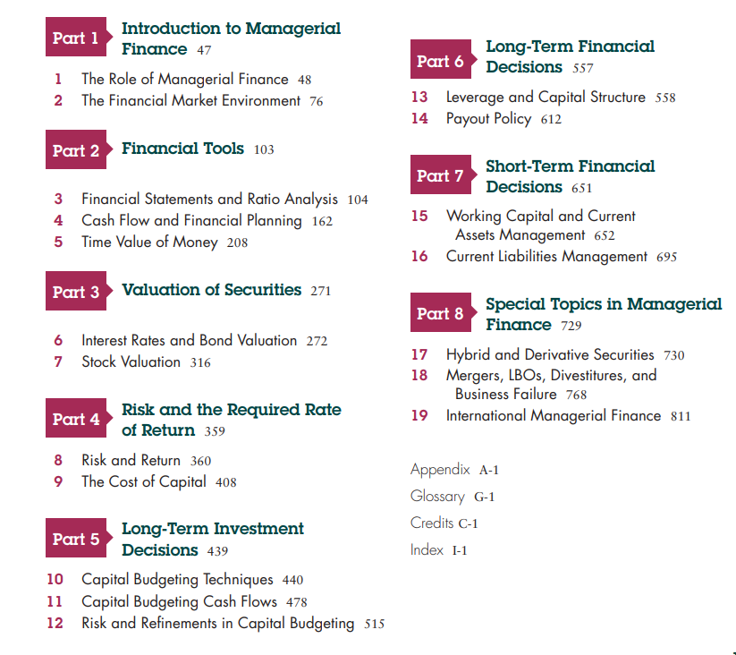

Slide 3

Chapter 1
The Role of Managerial Finance

Slide 4
Learning Goals
Define finance and the managerial finance function.
Describe the legal forms of business organization.
Describe the goal of the firm, and explain why maximizing the value of the firm is an appropriate goal for a business.
Describe how the managerial finance function is related to economics and accounting. identify the primary activities of the financial manager.
Describe the nature of the principal–agent relationship between the owners and managers of a corporation, and explain how various corporate governance mechanisms attempt to manage agency problems.

Slide 5
Financial Markets
Cash flows to the firm
Primary vs. secondary markets
  Dealer vs. auction markets
  Listed vs. over-the-counter securities
    NYSE
    NASDAQ
Notes:
Video Note: This video discusses how capital is raised in financial markets and shows an open-outcry market at the Chicago Board of Trade.
Discuss the cash flows to the firm. You might have students turn to Figure 1.2 in their book to see an illustration of the cash flows. The main point is that cash comes into the firm from the sale of debt and equity. The money is used to purchase assets. Those assets generate cash that is used to pay stakeholders, reinvest in additional assets, repay debtholders, and pay dividends to stockholders.
Students are often confused by the fact that the NASDAQ is an OTC market. Explain that the NASDAQ market site is just a convenient place for reporters to show how stocks are moving, but that trading does not actually take place there.
See the instructor’s manual for a discussion of an October 1999 BusinessWeek article concerning the move by the NYSE and the NASDAQ toward becoming for-profit companies and the possible impact on investors.
www: Click on the NYSE and NASDAQ hyperlinks to go to their Web sites

Slide 6
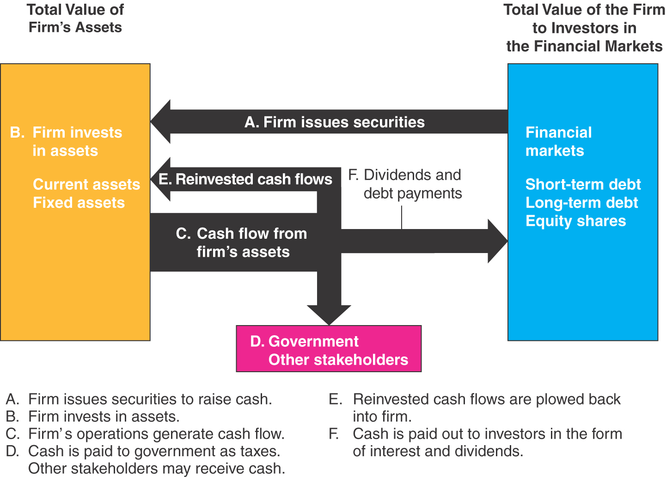
Figure 1.2

Slide 7
The Role of Managerial Finance
Learning Goals
Define finance and the managerial finance function.
Describe the legal forms of business organization.
Describe the goal of the firm, and explain why maximizing the value of the firm is an appropriate goal for a business.
Describe how the managerial finance function is related to economics and accounting.
identify the primary activities of the financial manager.
Describe the nature of
the principal–agent relationship between the owners and managers of a corporation, and explain how various corporate governance mechanisms attempt to manage agency problems.

Slide 8
1.1 Finance and Business
The field of finance is broad and dynamic.
Finance influences everything that firms do, from hiring personnel to building factories to launching new advertising campaigns. Because there are important

Slide 9
Meaning of Finance
Finance can be defined as the science and art of managing money.
At the personal level, finance is concerned with individuals’ decisions about how much of their earnings they spend, how much they save, and how they invest their savings.
In a business context, finance involves the same types of decisions: how firms raise money from investors, how firms invest money in an attempt to earn a profit, and how they decide whether to reinvest profits in the business or distribute them back to investors.

Slide 10
CAREER OPPORTUNITIES IN FINANCE
Financial Services- the area of finance concerned with the design and delivery of advice and financial products to individuals, businesses, and governments.
    banking,
    personal financial planning,
    investments,
    real estate,
    insurance.
Managerial Finance: concerned with the duties of the financial manager working in a business.
  private and public, large and small, profit seeking and not for profit.
  developing a financial plan or budget, extend credit to customers, evaluating proposed large expenditures, and raising money to fund the firm’s operations.

Slide 11

Forms of Business Organization
Three major forms in the United States
  Sole proprietorship
  Partnership
    General
    Limited
  Corporation
    S-Corp
    Limited liability company
Notes:
www: Clicking on the “Web surfer” will take you to a Web site that will provide a discussion about which form of business may be appropriate for an entrepreneur. The following pages will provide links to specific pages on the Web site that provide additional information about the legal aspects of each form of business, as well as a discussion of the advantages and disadvantages. The address is: http://www.nolo.com/encyclopedia/sb_ency.html#Subtopic16

Slide 12
Sole Proprietorship
Advantages
  Easiest to start
  Least regulated
  Single owner keeps all of the profits
  Taxed once as personal income
Disadvantages
  Limited to life of owner
  Equity capital limited to owner’s personal wealth
  Unlimited liability
  Difficult to sell ownership interest
Notes:
www: Click on the “Web surfer” for more information about sole proprietorships. If you click on the “--Sole Proprietorship” link, you will be taken to an index that will provide a link to information about husband and wife sole proprietorships.

Slide 13
Partnership
Advantages
  Two or more owners
  More capital available
  Relatively easy to start
  Income taxed once as personal income
Disadvantages
  Unlimited liability
    General partnership
    Limited partnership
  Partnership dissolves when one partner dies or wishes to sell
  Difficult to transfer ownership
Notes:
www: Click on the “Web surfer” for more information about partnerships. If you click on the “—Partnerships” link, you will go to an index that provides links to additional information about limited partnerships, partnership agreements, and buy-sell agreements.
Note that unlimited liability applies to all partners in a general partnership but only to the general partner(s) in a limited partnership
Written agreements are essential due to the unlimited liability.
Limited partners cannot be actively involved in the business or else they may be deemed general partners.

Slide 14
Corporation
Advantages
  Limited liability
  Unlimited life
  Separation of ownership and management
  Transfer of ownership is easy
  Easier to raise capital
Disadvantages
  Separation of ownership and management (agency problem)
  Double taxation (income taxed at the corporate rate and then dividends taxed at personal rate, while dividends paid are not tax deductible)
Notes:
www: Click on the “Web surfer” to go to a page that discusses corporations. If you click on the “—Corporations” link it will take you back to an index that provides links to additional information on corporations as well as limited liability corporations.
Discuss how separation of ownership and management can be both an advantage and a disadvantage:
Advantages
You can benefit from ownership in several different businesses (diversification)
You can take advantage of the expertise of others (comparative advantage)
It is easier to transfer ownership
Disadvantage
Agency problems if management goals and owner goals are not aligned
The instructor’s manual provides additional discussion of limited liability companies and S-corporations

Slide 15
Why Study Finance?
Marketing
  Budgets, marketing research, marketing financial products
Accounting
  Dual accounting and finance function, preparation of financial statements
Management
  Strategic thinking, job performance, profitability
Personal finance
  Budgeting, retirement planning, college planning, day-to-day cash flow issues
Notes:
Since this course is generally required of all business majors, it is important to emphasize that everyone needs to have a basic understanding of financial concepts so that they can communicate effectively within an organization. This is the same reason that everyone is required to take marketing courses, management courses, etc. It is important to speak the language of business, and that includes finance.
Marketing
Have to work within a budget
Marketing research is often very important to financial analysts; those doing the research need to understand what information the analysts need so that they ask the right questions
Marketing financial products – including entire companies through IPOs and seasoned equity offerings, as well as insurance and other basic financial products
Accounting
In smaller businesses, accountants often perform both the accounting and finance functions
Prepare the financial statements that financial analysts rely on for information
Management
Business strategy – have to understand the goals of the business and how cash flow works
Understand how job performance affects profitability
Personal Finance
For many students, emphasizing the personal finance issues whenever possible can make the material more relevant
Decisions about 401K plans, saving for houses, cars, child’s college, etc. can be discussed throughout the course
Day-to-day decisions about consumption vs. saving can also be discussed within a finance framework

Slide 16
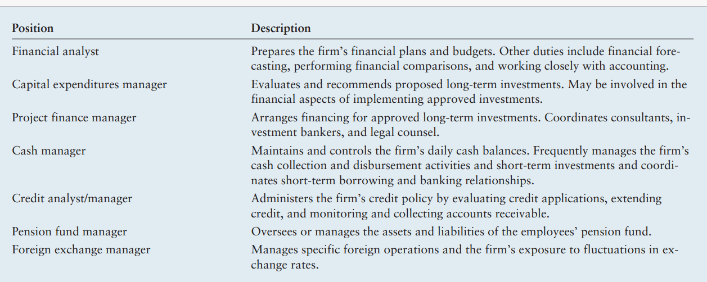
Career Opportunities in Managerial Finance

Slide 17
1.2 Goal of the Firm
Maximize the Shareholder Wealth
  managers’ primary goal should be to maximize the wealth of the firm’s owners, the stockholders.
Maximize Profit
  maximizing a firm’s share price is equivalent to maximizing its profits. It is measured by earning per share (EPS)

Slide 18
Goal Of Financial Management
What should be the goal of a corporation?
  Maximize profit?
  Minimize costs?
  Maximize market share?
  Maximize the current value of the company’s stock?
Does this mean we should do anything and everything to maximize owner wealth?
Sarbanes-Oxley Act
Notes:
Try to have the students discuss each of the goals above and the inherent problems of the first three goals:
Maximize profit – Are we talking about long-run or short-run profits? Do we mean accounting profits or some measure of cash flow?
Minimize costs – We can minimize costs today by not purchasing new equipment, or by delaying maintenance, but this may not be in the best interest of the firm or its owners.
Maximize market share – This has been a strategy of many of the dot.com companies. They issued stock and then used it primarily for advertising to increase the number of “hits” to their Web sites. Even though many of the companies may have huge market share (i.e. Amazon) that still does not guarantee positive earnings, so their owners may not be happy.
Maximize the current value of the company’s stock
There is no short run vs. long run here. The stock price should incorporate expectations about the future of the company and consider the trade-off between short-run profits and long-run profits.
The purpose of a for-profit business should be to make money for its owners. Maximizing the current stock price increases the wealth of the owners of the firm.
This is analogous to maximizing owners’ equity for firms that do not have publicly traded stock.
Not-for-profits can also follow the same principle, but their “owners” are the constituencies that they were created to help.
The instructors manual provides a letter to stockholders that was written by former Coca-Cola CEO Roberto Goizueta. There is also a brief discussion of an article that appeared in Fortune magazine that discusses Coke vs. Pepsi and their different philosophies on business in the early 1990s.
Ethics Note: See the instructor’s manual for a discussion of Dow-Corning, silicone breast implants, and the ethics involved with pursuing owners’ wealth at all costs.

Slide 19
1.3 Managerial Finance Function
The managerial finance function can be broadly described by considering its role within the organization, its relationship to economics and accounting, and the primary activities of the financial manager.
Organization of Finance Functions:
  CFO
      Treasurer: The firm’s chief financial manager, who manages the firm’s cash, oversees its pension plans, and manages key risks.
      Controller: The firm’s chief accountant, who is responsible for the firm’s accounting activities, such as corporate accounting, tax management, financial accounting, and cost accounting.
      foreign exchange manager The manager responsible for managing and monitoring the firm’s exposure to loss from currency fluctuations.

Slide 20
RELATIONSHIP TO ECONOMICS
Closely related to economics.
Understand the economic framework
be alert to the consequences of varying levels of economic activity
changes in economic policy.
Use economic theories as guidelines for efficient business operation.

Slide 21
RELATIONSHIP TO ACCOUNTING
The firm’s finance and accounting activities are closely related and generally overlap. In small firms, accountants often carry out the finance function; in large firms, financial analysts often help compile accounting information.
Two Differences
  Cash flows- cash basis vs. accrual basis
  Decision Making
      Accountant- collection and presentation of data for making decision
      Finance Manager: concerned with making decisions

Slide 22
PRIMARY ACTIVITIES OF THE FINANCIAL MANAGER
Primary Activities
  Investment Decision
  Financial Decision
  Working Capital Decision
  Capital Budgeting
  Distribution of Earnings
  Capital Structure Decisions

Slide 23
1.4 Governance and Agency
CORPORATE GOVERNANCE
The rules, processes, and laws by which companies are operated, controlled, and regulated.
Defines the rights and responsibilities of the corporate participants
Rules and procedures for making corporate decisions.
A well-defined corporate governance structure is intended to benefit all corporate stakeholders by ensuring that the firm is run in a lawful and ethical fashion, in accordance with best practices, and subject to all corporate regulations.

Slide 24
The Agency Problem
Agency relationship
  Principal hires an agent to represent its interests
  Stockholders (principals) hire managers (agents) to run the company
Agency problem
  Conflict of interest between principal and agent
Management goals and agency costs
Notes:
Video Note: This video focuses on how one company handled the tough decision to cut jobs and managed to successfully increase shareholder value. It features ABT Co. in Canada.
A common example of an agency relationship is a real estate broker – in particular, if you break it down between a buyer’s agent and a seller’s agent. A classic conflict of interest is when the agent is paid on commission, so they may be less willing to let the buyer know that a lower price might be accepted or they may elect to only show the buyer homes that are listed at the high end of the buyer’s price range.
Ethics Note: The instructor’s manual provides a discussion of Gillette and the apparent agency problems that existed prior to the introduction of the Sensor razor.
Direct agency costs – the purchase of something for management that can’t be justified from a risk-return standpoint; monitoring costs.
Indirect agency costs – management’s tendency to forgo risky or expensive projects that could be justified from a risk-return standpoint.

Slide 25
Mitigating Agency Problem
Institute Attractive Compensation Packages
  Incentive plans
  Stock Options
Board of Directors’ Monitoring and Evaluation
Critically Evaluating the Financial Reporting
Hostile Takeover

Slide 26
Basic Areas Of Finance
Corporate finance
Investments
Financial institutions
International finance
Notes:
Each of these topics will be discussed in more detail in the following slides.
www: Several of the following slides will have hot links to a Web site that provides information about different business jobs including descriptions, skills and traits, etc. The address is www.careers-in-business.com
Video: Advice from recent graduates on what it takes to have a career in finance.
The discussion on corporate finance is deferred until later in the chapter.

Slide 27
Business Finance
Some important questions that are answered using finance
  What long-term investments should the firm take on?
  Where will we get the long-term financing to pay for the investments?
  How will we manage the everyday financial activities of the firm?
Notes:
Emphasize that “business finance” is just another name for “corporate finance” mentioned under the four basic types. Students often get confused by the terminology, especially when different terms are used to refer to the same thing.

Slide 28
Investments
Work with financial assets such as stocks and bonds
Value of financial assets, risk versus return, and asset allocation
Job opportunities
  Stockbroker or financial advisor
  Portfolio manager
  Security analyst
Notes:
www: Clicking on the “Web surfer” icon will take you to the Careers in Business Home Page. The “Money Management” option discusses careers as portfolio managers, mutual fund analysts, etc. The “Financial Planning” section discusses careers as financial consultants.

Slide 29
Financial Institutions
Companies that specialize in financial matters
  Banks – commercial and investment, credit unions, savings and loans
  Insurance companies
  Brokerage firms
Job opportunities
Notes:
www: Clicking on the “Web surfer” icon will take you to the Careers in Business Home page. “Commercial Banking”, “Insurance,” and “Investment Banking” all discuss job opportunities in the Financial Institutions area.

Slide 30
International Finance
This is an area of specialization within each of the areas discussed so far
It may allow you to work in other countries or at least travel on a regular basis
Need to be familiar with exchange rates and political risk
Need to understand the customs of other countries; speaking a foreign language fluently is also helpful

Slide 31
Quick Quiz
What are the four basic areas of finance?
What are the three types of financial management decisions, and what questions are they designed to answer?
What are the three major forms of business organization?
What is the goal of financial management?
What are agency problems, and why do they exist within a corporation?

